Slide 1
Solar Program Overview

Slide 2
Topics to Review
Trico Webpage
Residential and Commercial Tariffs
Fixed Monthly Fees
Contractor Responsibilities
Interconnection Application Process

Slide 3
Where can you find solar program information?
Trico Website: Trico.Coop

Slide 4
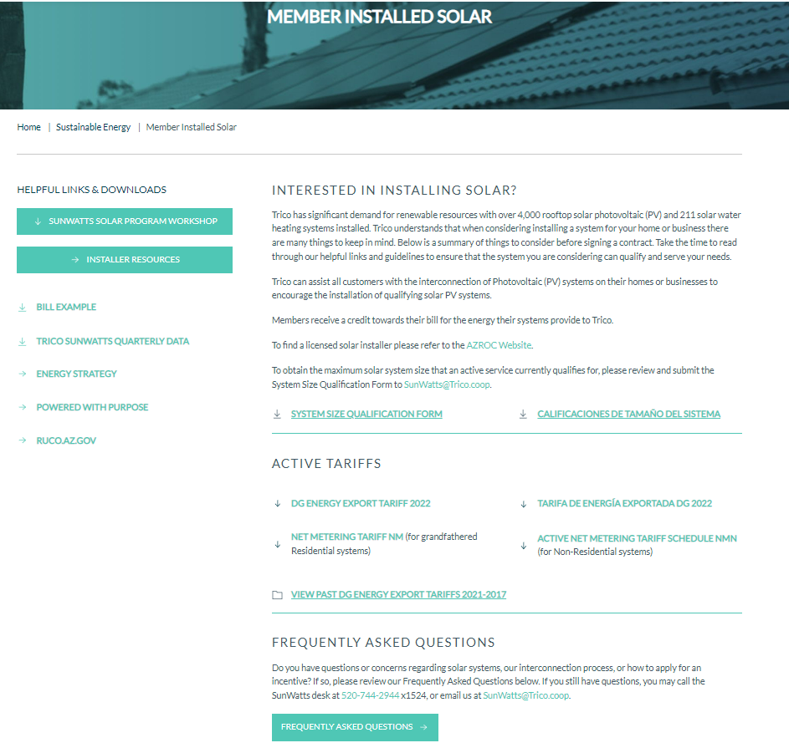
All resources for Installers
Bill Examples
Max. System Size Qualification Form – We recommend completing this prior to a PV application being submitted.
Current DG Energy Export Tariff

Slide 5
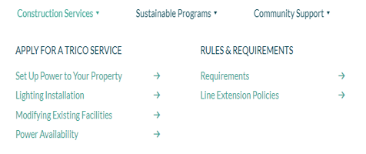
Where can you find Construction/PowerKill information?
Trico Website: Trico.Coop
When a Main Service Panel (MSP) is being modified by derate, Main Panel Upgrade (MPU) or relocation, an alteration application will be required and can be found on the Modifying Existing Facilities link.
Once the PV application has been approved, please contact (520) 744-2944 ext. 1383 to schedule a PowerKill
Electric Service Requirements, such as required labels, can be found on the Requirements link.

Slide 6
Residential Tariffs
Net Metering- NM
Members must be grandfathered prior to February 24, 2017
NM is available for commercial services
Bank excess solar generation
One-to-one credit for excess solar generation sent back to Trico
Bill calculation is based on net of energy delivered and energy received
*NM is not available to Residential Solar Members*
DG Energy Export-DGEE
All new residential solar members as of February 24, 2017
Excess generation credited at applicable tariff rate
No banking!
Tariff is determined by date of application submission
New tariff goes into effect March 1 of each year

Slide 7
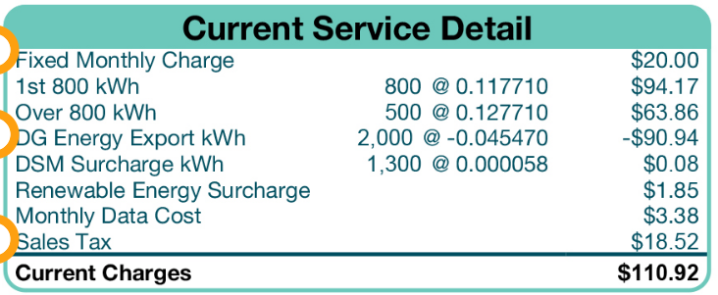
Fixed Monthly Fees
Please note that our members will still receive a monthly bill even if the system is breaking even on consumption/generation.

Slide 8
Contractor Responsibilities
Prepare an estimate, to include system size and financial obligations.
Recommended to complete the System Size Qualification Form prior to submitting the PV application
Be educated on Trico’s Interconnection Requirements, Rate Tariffs, and Interconnection Application process.
See previous slides for where to find this information
Responsible for submitting Interconnection Application to Trico.
Including: Required permits, engineered plan set, member documentation, and all other required documents.

Slide 9
Interconnection Process - PowerClerk
Please reference your 3-line diagram to ensure this question is answered appropriately. An automated email will be sent when “Yes” is selected with information on submitting the Alteration Application.

Slide 10
Interconnection Process - PowerClerk
Please utilize the member’s bill to ensure this information is accurate (the service address needs to be listed, not the mailing address).
The member’s email address is required
Applications will not be accepted if the email address belongs to the contractor.
These two numbers are added together, and the sum of these numbers MUST match the System Quote that is uploaded.

Slide 11
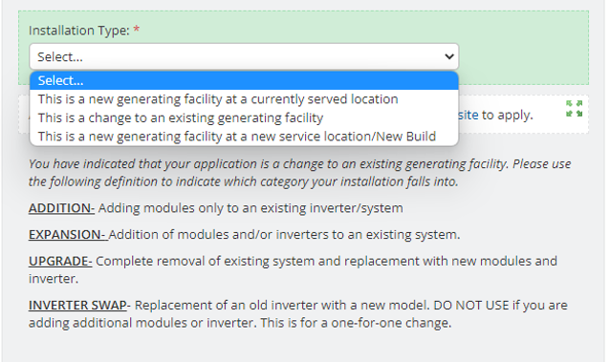
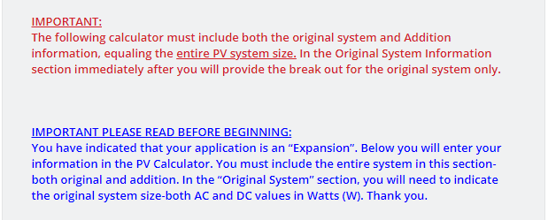
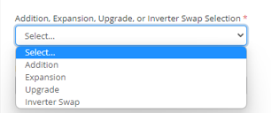
Second Phase Applications
When applying for a second phase, page 1 of the application will ask to select the type of second phase:
If it will be an expansion/addition, the following note will come up on page 4 of the application:
Please ensure ALL equipment (old and new) is accounted for here.
Please note:
Any change to the generating capacity of a Net Metered System will result in the member moving to the current DG Energy Export Tariff.
For members who are already on a DG Energy Export Tariff, if the capacity increases by 10% or 1kW (whichever is greater), they will also move to the current DG Energy Export Tariff.
For battery only second phase applications, please select Addition on page 1.

Slide 12
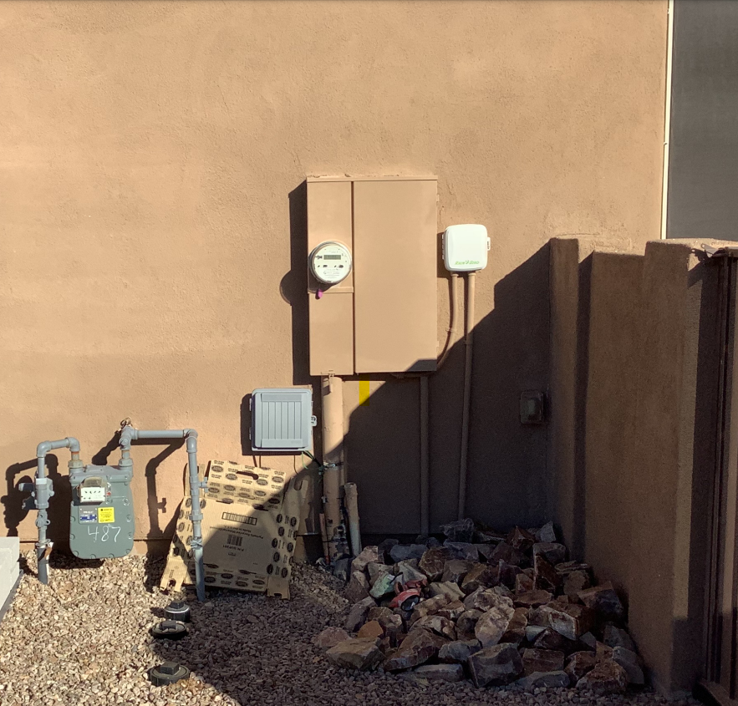
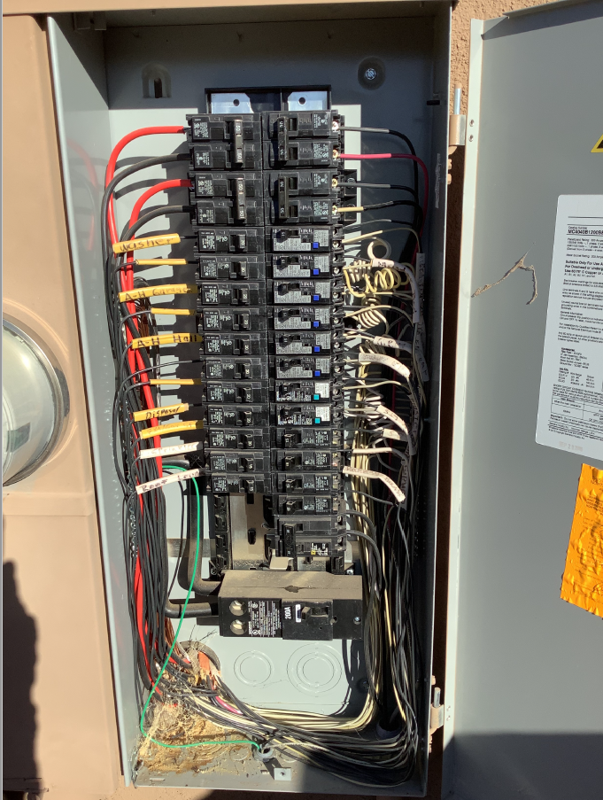
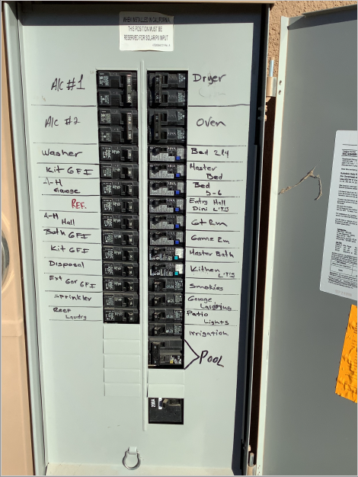
Interconnection Process – PowerClerk Miscellaneous Items
Main Service Panel Photo Examples:
MSP Location – With 10ft surrounding area
MSP with Cover Removed – Full Panel is Visible
MSP with Cover

Slide 13
Interconnection Process – PowerClerk Miscellaneous Items
Ask a Question:
Under the View/Edit Screen you can submit inquiries/questions regarding the project
Changes Form:
Should only be utilized if changes are being made to the plans/application.
Notes:
If changes are needed to an application, please check if it Changes Form is available on the View/Edit screen under Available Forms. If it is not there, please email or call and we will open the form for you. The Changes Form is specifically for actual changes to the plans and/or application.

Slide 14
Processing Timeframes - PowerClerk
When a project is submitted, Trico will complete the initial administrative and design review within 7 days from the submission date.
If any corrections are needed at either stage, contractors will have 30 days to make the necessary changes, or the application will be canceled, unless a Project Extension is requested.
If the MSP is being modified, the project will remain in Secondary Utility Review until an Alteration Application has been received.
If not received within 30 days, applications will be canceled if a Project Extension is not requested.
The installation or modification of any equipment should not be completed until the required application/s have been Approved.
The application will remain in an Application Approved status until the Final Docs are received.
Please note that the system must be fully operational at the time of inspection.
If the system does not have Permission to Operate within 180 days from the application approved date, the project will be canceled, unless a Project Extension Request is submitted.
Once a project goes into the Inspection Queue, there is a 2-week* window for our meter techs to go out and do their final inspection.
Trico will provide a formal PTO within 3 days of meter set.
Notes:
*This timeframe may change dependent upon workload for our meter techs*

Slide 15
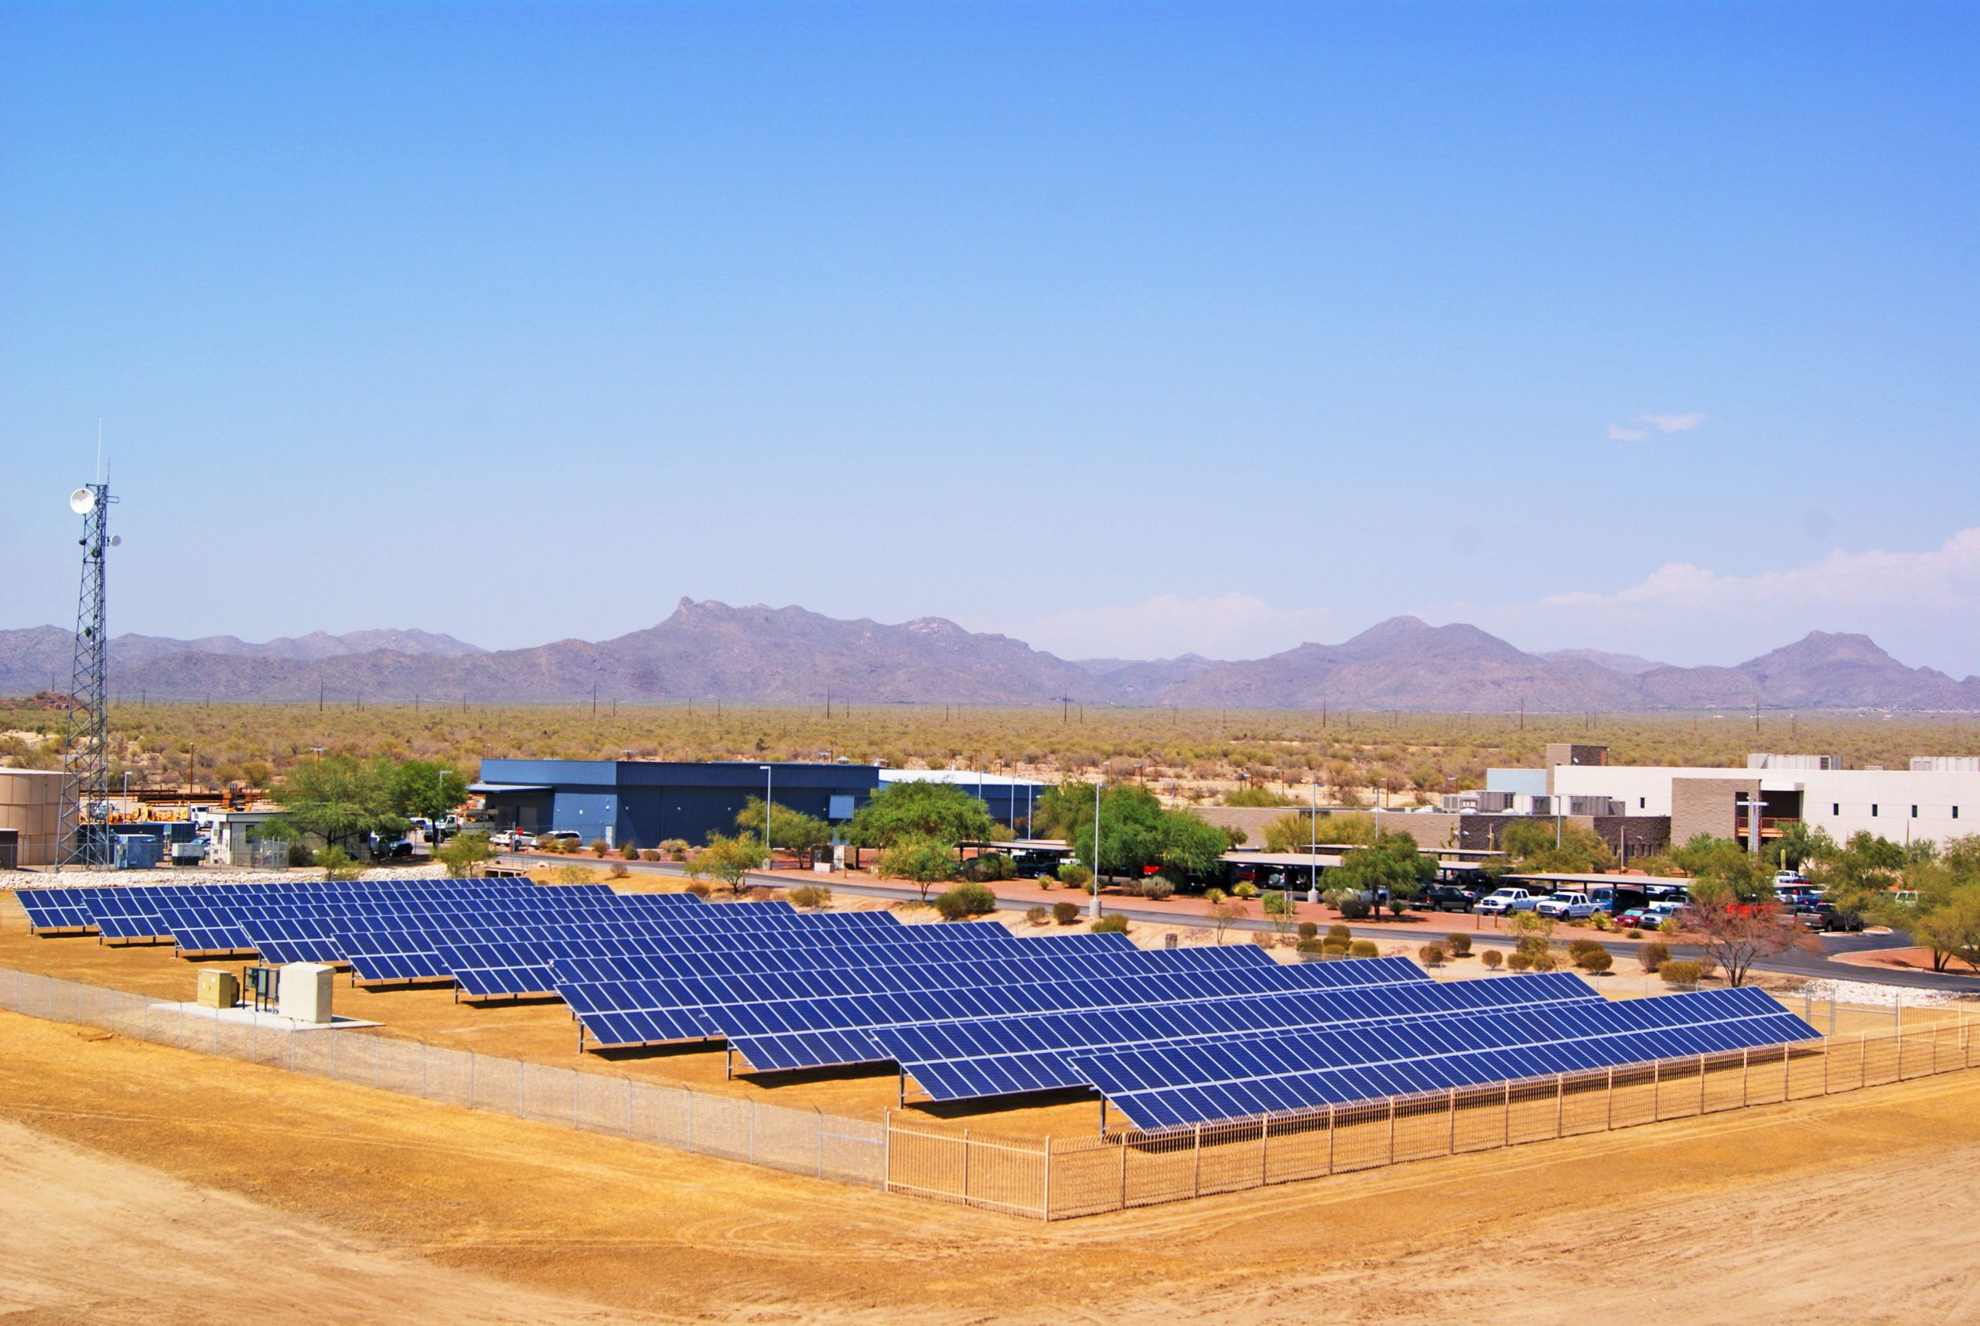
Please ask questions, we are here to help!
Sunwatts@trico.coop
Ext. 1524

