Slide 1
SunWatts Solar Program
Member Workshop

Slide 2
Welcome!
Chelsea Mead
Senior Renewable Resources & Energy Efficiency Specialist
520-744-2944 ext. 1524

Slide 3
Workshop Overview
Our Purpose
The purpose of this workshop is to provide educational resources to Trico members who may be considering solar interconnection.
Our Goal
Our goal is for our members to feel equipped with the information and resources necessary to make informed decisions when considering solar interconnection.

Slide 4
Workshop Topics
Trico’s Renewable Resources and Programs
Contractor Selection
Trico’s Interconnection Application Process
Renewable Energy Rate Tariffs
Educational Resources

Slide 5
Trico’s Community Scale Resources
Community Scale Renewable Resources
SunWatts Sun Farm
Apache Solar
Avion Solar
Chirreon Solar and Storage
Trico’s existing community scale systems provide enough renewable energy to power more than 4,500 homes.

Slide 6
SunWatts Member Installed Solar
Member installed programs started in 2005
5,000+ installed retail solar systems
68+ new solar interconnections each month
700+ new installations in 2022
Represents about 70% of Trico’s total renewable portfolio

Slide 7
Considering Going Solar?

Slide 8
Fact or Fiction
I will no longer have a utility bill with Trico
Trico raises their rates annually
Trico hires solar sales teams to go door to door
Trico does not want me to go solar
Trico has my best interests in mind

Slide 9
System Size Qualification Form
Determines maximum system size service qualifies for
125% of highest peak demand in the last 12 months
75% of transformer capacity
https://www.trico.coop/wp-content/uploads/System-Size-Qualification-Form1.pdf

Slide 10
Contractor Selection
Trico does not sell or install solar systems
Trico does not have a preferred vendors list and holds no contracts with installers
The third-party installer is selected by the member
It is recommended to contact a minimum of three contractors

Slide 11
How do I Find a Contractor?
Must have an active Contractor’s License in the state of Arizona
Self-installations require a licensed electrician to complete the final interconnection
The Arizona Registrar of Contractors provides a search option for licensed contractors
https://roc.az.gov/contractor-search
Referrals

Slide 12
Do your Research…
Review business rating and qualifications
Better Business Bureau
The Arizona Attorney General’s Office
How long has the contractor been in business?
What is their experience?
Where are their headquarters, do they have a local branch?
Will they provide a list of references?

Slide 13
What Questions do I ask?
How much will this system cost over the life of the lease or purchase? Are there any interest or fees to be paid? What are total number of payments and due dates?
Who has the tax obligations, including the increase in property values?
Are there any eligible tax incentives and rebates? Who will be getting them?
Can the warranty or maintenance obligations be sold or transferred? If so, how?
Who do I contact in the event of a system malfunction?
What happens if I sell my home? What happens to the lease?
What statistics are you using for the projection of future electric rates?
What is the minimum performance guarantee for the system?
Will I be compensated if the system does not produce as much power as promised?

Slide 14
Contractor Responsibilities
Prepare an estimate, to include system size and financial obligations.
Be educated on Trico’s Interconnection Requirements, Rate Tariffs, and Interconnection Application process.
Responsible for submitting Interconnection Application to Trico, including:
Required permits, engineered plan set, member documentation, and all other required documents.

Slide 15
What do I Review Before Signing?
Utility Documents
Trico maximum system size qualifications
Confirm the largest size system your service qualifies for
Applicable Rate Tariff
Understand the metering, billing, and fees associated with your applicable tariff
Terms and Conditions
Understand the Terms and Conditions of your agreement with Trico.

Slide 16
What do I Review Before Signing? (cont.)
Contractor Documents
Thoroughly understand the terms of your contract
Incentives and Rebates
Tax obligations
Payment details
Warranty and maintenance agreement
Performance guarantee
Transfer of ownership/Sale of home
Understand the terms of your contract as they apply to your contractor, sales company, and financing partner.
Understand all parties associated with your contract
Request contacts for all associated parties
What is each party responsible for after your system has been installed
Contact legal council or tax professional if there are terms of the contract that need further clarification

Slide 17
Renewable Energy Rate Tariffs
Residential Services:
DG Energy Export
Exported energy is credited during billing period at applicable export rate
Metering is bi-directional
10-year grandfathering

Slide 18
Interconnection Application Process
An Interconnection Application is required to be submitted to Trico for all interconnections, including:
All grid-tied solar systems, self installations, stand-alone battery systems, and second phases to existing systems.
Application will be submitted electronically by the contractor through the online PowerClerk application portal.

Slide 19
Processing Timeframes - PowerClerk
When a project is submitted, Trico will complete the initial administrative and design review within 7 business days from the submission date.
If any corrections are needed at either stage, contractors will have 30 days to make the necessary changes.
If the corrections are not made, the application will enter a Pending Cancellation Status and an automatic 7-day deadline reminder will be emailed. Your contractor is responsible for requesting a one-time courtesy extension within those 7 days, if it is not received the application will be canceled.
The installation or modification of any equipment should not be completed until the required application have been Approved.
The application will remain in an Application Approved status until the Final Docs are received.
Please note that the system must be fully operational at the time of inspection.
Once a project goes into the Inspection Queue, there is a 14-business day window for our meter techs to go out and do their final inspection.
Trico will provide a formal PTO within 3 business days of meter set.
If the system does not have Permission to Operate within 180 days from the application approval date, the application will enter a Pending Cancellation Status and an automatic 7-day deadline reminder will be emailed. Your contractor is responsible for requesting a one-time courtesy extension within those 7 days, if it is not received the application will be canceled.
Notes:
*This timeframe may change dependent upon workload for our meter techs*

Slide 20
Application Documentation
Contractor Supplied:
Required Jurisdiction Permitting
Field Photos
Engineered Plan Set
System Quote
Member Supplied:
Executed Tariff Application
Executed Terms and Conditions

Slide 21
Application Submitted
Application will be reviewed within 7 business days from the date received.
An email notification will be sent upon application approval, and continued notifications will be sent to inform member of the application status.
Upon approval, contractor is responsible for installation schedule and completion.
*System should not be installed prior to an approved application from Trico*

Slide 22
System Installed
Contractor will contact jurisdiction to schedule inspection. Inspection must pass prior to Trico’s final inspection.
Contractor will request Trico’s final inspection by providing the following:
Jurisdiction Inspection Clearance
Final Building Permit
Final Plan Set (including any revisions)

Slide 23
Trico Final Inspection
Meter technician will perform inspection based on the following criteria.
System installed per approved plan set
System Meets Trico Interconnection Requirements
All equipment is operating safely and correctly
Trico will perform meter change and installation on site at time of passed inspection.
The formal Permission to Operate will be provided after approved inspection for member and contractor records and will be dated with the inspection date.

Slide 24
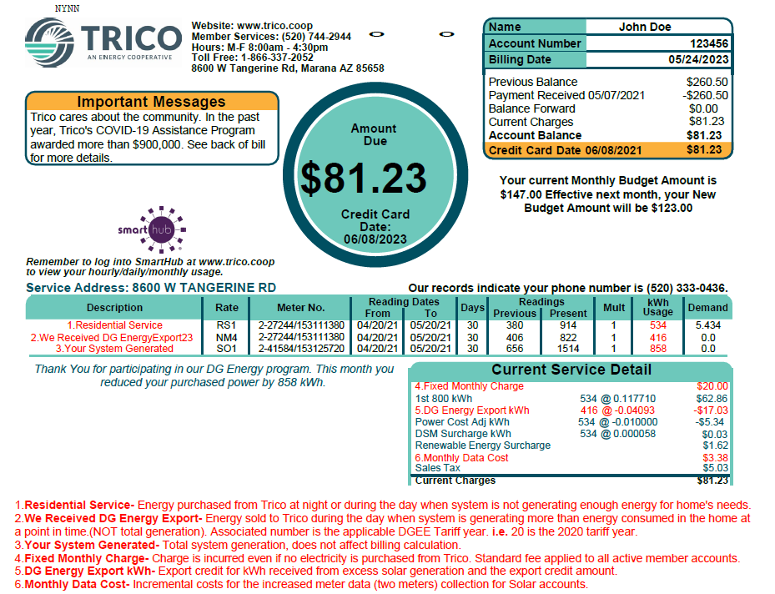

Slide 25
Is this number consistent?
Is this number reporting zero?
Is this number in line with your performance guarantee?
Is this number increasing since going solar?
Is this number significantly higher than last year?
Is this number significantly higher than my solar generation?
Is a large portion of my solar generation being sent back to Trico?

Slide 26
The Solar Lifestyle
Time of day and usage
Peak generating hours
Timers
Nighttime usage
Weather
Energy Efficiency
Thermostat settings
Home systems

Slide 27
Educational Resources
SunWatts webpage: Member Installed Solar. The Renewable Energy Tariffs can also be viewed here. We also provide a list of suggested questions to ask contractors and a list of frequently asked questions with full responses, and the maximum system size qualification form.
Licensed contractor searches can be completed here: https://roc.force.com/AZRoc/s/contractor-search
“Be Smart” Consumer Tools: https://irecusa.org/programs/consumer-protection/
Residential Utility Consumer Office, AZ, Consumer Guide for Rooftop Solar: Consumer Resources | Residential Utility Consumer Office (az.gov)Federal Trade Commission, Consumer Information, “Rays on the Roof”: Search | Consumer Advice (ftc.gov)

Slide 28
Chelsea Mead
Senior Renewable Resources & Energy Efficiency Specialist
Tanya Terranova
Renewable Resources & Energy Efficiency Specialist
Laree St. Onge
Manger Member and Energy Services
Sunwatts@trico.coop
520-744-2944 ext. 1524

